Slide 1
Responsive enterprise mobile development
Day 5

Slide 2
recap
Notes:
We assigned 10 minutes to this topic.

Slide 3
REcap
Achieving Delight with Hybrid
AFNetworking
Core Data
Javascript to Native Bridging with HTTP Request Intercepts and Core Data
Objective-C Dependency Injection
Unit Testing with XCTest and OCMock
Authentication
.NET/Java Pattern Mapping
JavaScript Inheritance & Composition

Slide 4
On the dance card for today
Xcode 5 Interface Builder
LAB: Write a pure native iOS app in Xcode using iOS7 UIKit Dynamics!
Xcode Continuous Integration
Instruments and Xcode Instruments integration
LAB: Find and fix a memory leak in Scavhn with Instruments
Threading Blocks and Grand Central Dispatch
Javascript to Native Bridging
LAB: Convert Scavhn’s Camera View into native modal dialog
Parking Lot

Slide 5

Interface Builder
Notes:
We assigned 60 minutes to this topic and the simple lab which follows.

Slide 6
Interface builder
UI Designer for iOS and OSX applications
Began life as a separate application
Integrated into Xcode with v4

Slide 7
Interface builder
Views began life as NIBs
Xcode 4 introduced Storyboards
ViewControllers are “patched” to Views and UI Controls through IBOutlets
CTAs are “patched” to IBActions

Slide 8
Interface builder
Very rudimentary set of controls, geared toward leaving it to the Dev to style
Notes:
First Bullet: Coming from Visual Studio, this is a bit different. UI widgets are very bare, as you will see.

Slide 9

Lab: Interface Builder
Notes:
Dee: How is this lab going to be different from the Hello World app the students created on Day 1?

Slide 10
Lab: Interface Builder
In this lab, you will…
Build a basic Single View app with some UIKit Dynamics goodness
Notes:
Lab purpose slide – I don’t know what to fill in on this one.

Slide 11
Lab: Interface Builder
Build a basic single view application with a button, a ball, and a label
Wire up the label, the ball, and the button to the viewController
Do stuff
Notes:
Lab details slide

Slide 12
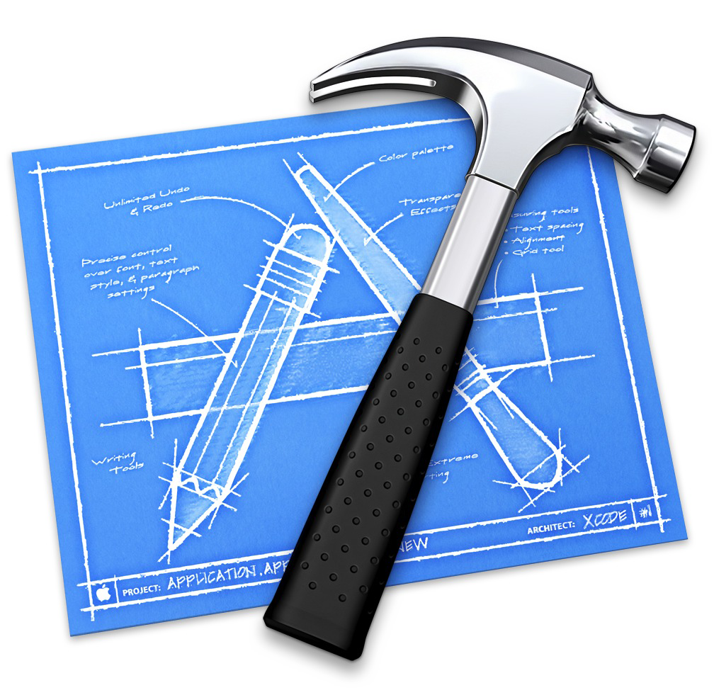
Tools we’re using for this lab
Xcode 5

Slide 13
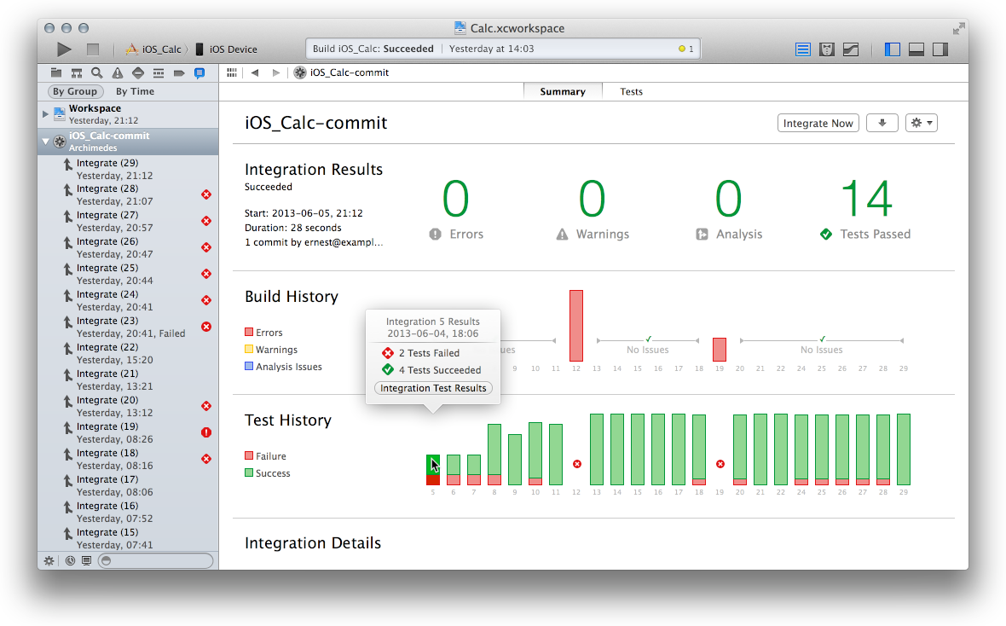
Continuous integration builds with bots
Notes:
We assigned 60 minutes to this topic.

Slide 14
CI builds with bots
Continuous Integration – new to Xcode 5
Bots – Automation blocks. Think Nant.
Log Navigator – Web UI

Slide 15
Lab: Continuous integration
Notes:
Dee: How is this lab going to be different from the Hello World app the students created on Day 1?

Slide 16

Tools we’re using for this lab
Xcode 5
OSX Server’s
Xcode Server

Slide 17
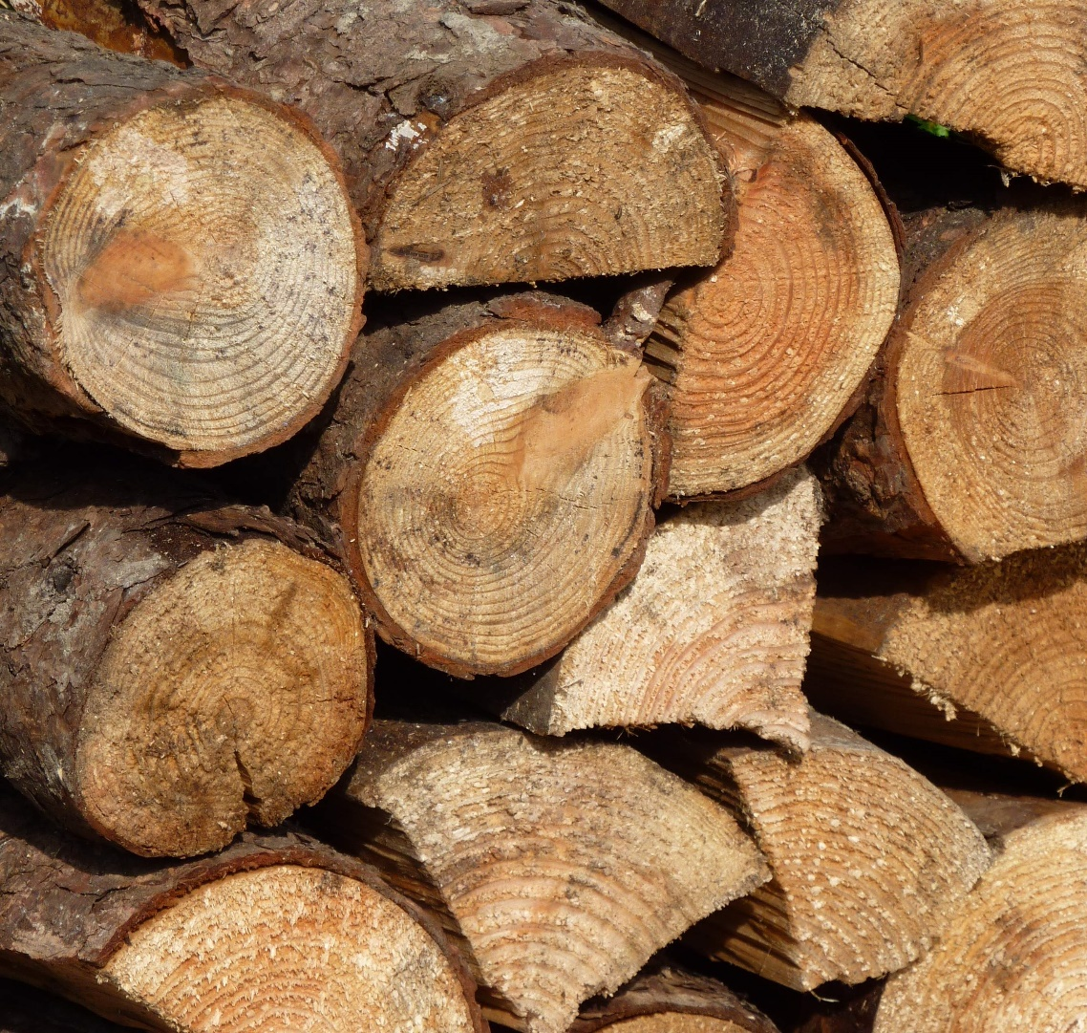
Builds logging
Notes:
We assigned 15 minutes to this topic.

Slide 18
Builds logging
How to ferret out problems

Slide 19
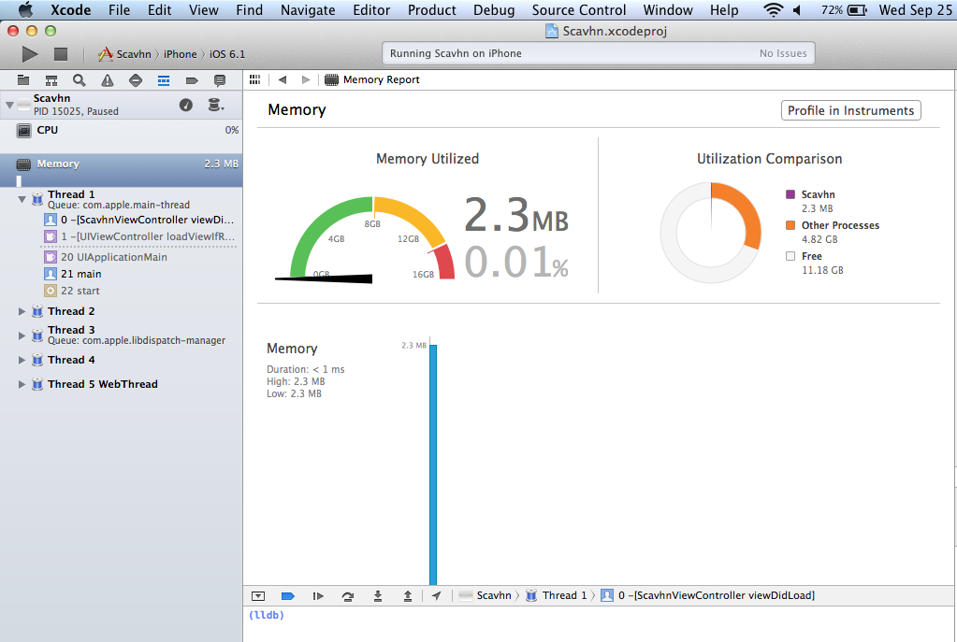
instruments
Notes:
We assigned 60 minutes to this topic.

Slide 20
instruments
Originally a separate tool
Now runs as separate tool and integrated into Xcode
Like a Task Manager for iOS. Provides memory/CPU/resources metrics

Slide 21
Lab: memory profiling
Notes:
Dee: How is this lab going to be different from the Hello World app the students created on Day 1?

Slide 22

Tools we’re using for this lab
Xcode 5
Instruments

Slide 23

Threading, blocks, and GCD (Grand Central Dispatch)
Notes:
We assigned 60 minutes to this topic.

Slide 24
Threading, blocks, and GCD (Grand Central Dispatch)
Blocks == Funcs for Objective-C
Grand Central Dispatch
Threading

Slide 25

Threading, blocks, and GCD (Grand Central Dispatch)
This book:

Slide 26

JavaScript to iOS bridging: getting from hybrid to native, mixing views
Notes:
We assigned 60 minutes to this topic.

Slide 27
JavaScript to iOS bridging
Javascript > iOS: HTTP Intercepts
To Review:
Javascript can interact with native code by sending commands via HTTP requests
Your app can intercept and do something meaningful with these requests through the use of UIWebViewDelegate and overriding its
-(BOOL)webView:(UIWebView *)webView shouldStartLoadWithRequest:(NSURLRequest *)request navigationType:(UIWebViewNavigationType)navigationType
method

Slide 28
Getting from Hybrid to native
iOS > Javascript: stringByEvaluatingJavaScriptFromString
Remember – A UIWebView is just another view type.
It can be combined with other views.
It can be incorporated into a UINavigationView to facilitate navigation from a UIWebView to a native UIWebView.

Slide 29
Lab: mixing hybrid and native
Notes:
Dee: How is this lab going to be different from the Hello World app the students created on Day 1?

Slide 30
Mixing hybrid and native lab will focus on:
HTML / CSS
HTML5
SASS / COMPASS
LIVE EDIT
JAVASCRIPT
REQUIREJS
BACKBONE / UNDERSCORE
JQUERY
iOS - OBJECTIVE-C
UIWEBVIEW
AFNETWORKING
CORE DATA

Slide 31





Tools we’ll be using
HTML / CSS
Safari
WebStorm
Photoshop
Chrome
JAVASCRIPT
Safari
JetBrains WebStorm
Chrome
iOS - OBJECTIVE-C
Xcode 5
JetBrains AppCode

Slide 32

Parking lot list
Notes:
We assigned 60 minutes to this topic, but we expect to go over. Ask people to stick around until 5:30, and tell them that they are free to leave after that. But you will keep going until the parking lot list is done.

Slide 33
Parking lot list

Slide 34
That’s enough!
Thank you for attending the REMD course.

